Slide 1
Introduction to Human Practices
Notes:
In the early years of the Synthetic Biology Engineering Research Center, or SynBERC, UC Berkeley professor Paul Rabinow introduced the phrase ‘human practices’ into the lexicon of genetic engineering. It has become a popular term referring to diverse aspects of how technology interacts with people’s lives. The term is often reduced to simply ‘practices’ and the scope of its meaning is increasingly broad. Synthetic Biology practitioners use this term to refer to issues of biosafety and biosecurity, intellectual property, government regulation, public perception, and education.

Slide 2
Intellectual property
Should parts be patented?
Dangers of overstated patents and thickets (Ex. Uaa, GFP)
BioBrick Public Agreement and Open Source
Application specific ethics
Fuel versus food in biofuels
Hybrid/GMO seeds (ie Round-Up ready seeds)
Biosafety, Biosecurity, and Regulation
Notes:
There are many issues around intellectual property in genetic engineering. Though the supreme court occasionally has decisions around the patentability of genetic sequences, the question of what is patentable remains controversial. Beyond its legal status, there are many who question whether it is ethical for people to secure IP over parts, and if so, is it all parts or just some parts. For example, few criticized the patenting of pathways to key metabolic intermediates that involved the coordinate expression of many genes, but the patenting of the individual protein-coding sequences is often considered too low of a threshold. Nevertheless, such patent claims are frequently issued. Another concern are frequently overstated and overlapping claims in patents and thickets. For example, the patents for GFP and unnatural amino acid incorporation describe such all-encompassing claims about the potential compositions and uses of this area of biology that it would likely be impossible to operate in these spaces without securing a license. These concerns over creating an overly complex and limiting intellectual property landscape have led some to propose increased availability of open source parts and alternative approaches to patents such as the BioBrick public agreement.
Other practices issues relate to specific applications of the technology. For example, extensive biofuel efforts have prompted concerns that competition between farming food and farming biofuels would lead to increased food costs. Additionally, there have been ongoing concerns over all aspects of genetically-modified foods and particularly around the business practices of hybrid GMO seeds.
Finally, there are many concerns around biosafety and biosecurity. Biosafety refers to the accidently harm caused by working with biological agents without consideration of proper risk mitigation. Biosecurity refers to the intentional cause of harm to plants, animals, or humans with a biological agent. These concerns can be generalized as regulatory in nature where they are combined with additional concerns such as harm to the environment or to commerce.

Slide 3
Government Regulation
In industry, companies directly interact with OSHA (Occupational Safety and Health Administration) to deal with issues of biosafety.
Products containing modified DNA may be subject to additional federal regulation based on certain triggers, for example:
Therapeutics/Diagnostics (FDA)
Biofuels for automobiles (ASTM)
Environmental risk to plants/animals (USDA)
Commercially-associated environmental exposure (EPA)
Notes:
The research done in academic labs around biological agents of any sort follows the guidelines set forward by the NIH. This same list of biosafety and biosecurity concerns affects industry through OSHA regulations. However, biosafety and biosecurity are not the only cocerns that affect commercialization of a genetic engineering product. For example, any claims about therapeutic potential or accuracy of a diagnostic method would face the scrutiny of the Food and Drug administration. For biofuel products, the quality and consistancy of the fuel product would fall under ASTM scruity to guarantee that bad fuel doesn’t cause airplanes to fall out of the sky or cars to crash. Concerns over the environmental risk to plant and animal life of agrigultural interest would fall under the USDA. Commercial interests that do not fall under the FDA or USDA are typically handled by the EPA. For example, if you wish to release bacteriophage into the environment, this would most likely fall under the EPA. These agencies all have specific mandates and triggers. For example, EPA can only regulate commercial efforts thus DIY or NGO efforts may escape their purview.

Slide 4
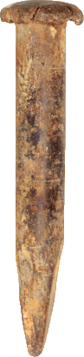
Known and Unknown Risks
“There are known knowns; there are things we know we know.
We also know there are known unknowns; that is to say, we know there are some things we do not know.
But there are also unknown unknowns – the ones we don’t know we don’t know.”
—United States Secretary of Defense, Donald Rumsfeld
http://en.wikipedia.org/wiki/There_are_known_knowns
Known risks
Fuzzy risks
Unknown risks
Notes:
One overarching concern over genetic engineering is unknown risks. As Donald Rumsfeld famously stated, there are known knowns; there are things we know we know. We also know there are known unknowns; that is to say, we know there are some things we do not know. But there are also unknown unknowns – the ones we don’t know we don’t know. This potential for unknown unknowns with harmful consequences is the heaviest concern facing synthetic biology. The fear is that there will be modified organisms, that though they undergo thorough consideration and oversight, nevertheless result in harm that nobody anticipated. Though this has never happened, there is a lack of clarity around the theory of leaves open the concern of hypothetic risks that may in reality be impossible.

Slide 5
Traditional Biological Risk Assessment
Regulations and Administrative Controls
Risk Groups and Biosafety Levels
Select Agents
Dual-Use

Slide 6
Regulated Research
(Related to synthetic biology, NIH Guidelines)
http://oba.od.nih.gov/rdna/nih_guidelines_oba.html
Biohazards
Environmental Health and Safety (EH&S) / Committee for Laboratory & Environmental Biosafety (CLEB)
Animal experiments
Animal Care and Use Committee (ACUC)
Radiation work / Lasers / Chemicals
Environmental Health and Safety (EH&S)
Human stem cells
Cell Research Oversight Committee (SCRO)

Slide 7

Elements of Biosafety
Risk Groups
Biosafety Levels
Select Agents
Regulation

Slide 8
Biohazardous Agents
Infectious or pathogenic agents capable of causing disease in healthy humans, plants and animals such as:
Bacteria
Virus
Fungi
Parasites (Ex. Ringworm)
Rickettsia

Slide 9
Assessment of Risk
Factors considered in determining the level of containment include the following information regarding the agent itself:
Virulence/pathogenicity/infectious dose (ex. Shigella)
Environmental stability (ex. spores)
Route of spread, communicability (ex. flu)
Quantity/concentration/volume used (ex. bioreactor)
Vaccine/Treatment availability (ex. Hep B)
Allergenicity (ex. peanuts)

Slide 10

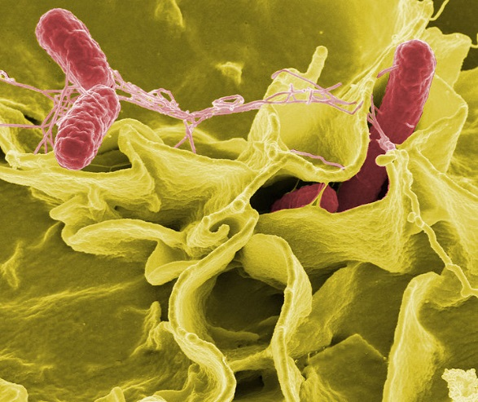
Classification of Agents
Appendix B of the NIH Recombinant DNA Guidelines is based on the WHO Risk Group classification:
Risk Group 1 agents: not associated with disease in healthy adult humans
Risk Group 2 agents: associated with human disease which is rarely serious and preventive or therapeutic interventions are often available
MG1655
Salmonella
Notes:
Everything that is a known known belongs to a risk group. Combined with the assessment of volumes involved, specific procedures, etc., you can find out from the Guidelines what category your research is in, and they have recommendations about how to do the experiment (ie, what kind of facility to work in, what kind of hoods to use, etc.).
So, if you engineer a bug, and then you do a bunch of clinical assays, you could empirically assign it to a risk group.
However, that’s no good here – you have to make decisions about biosafety before the organism exists to protect yourself and the community. The guidelines do a weak job of dealing with all this, except for obvious cases, and they don’t get into the issue of unknown unknowns at all.
Hence, there has always been this debate….

Slide 11
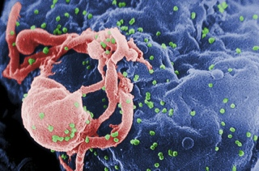
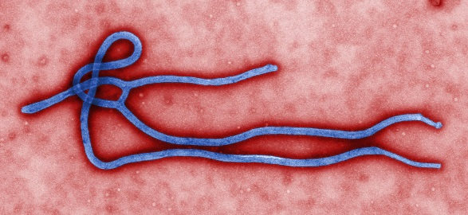
Classification of Agents
Appendix B of the NIH Recombinant DNA Guidelines is based on the WHO Risk Group classification:
Risk Group 3 agents: associated with serious or lethal human disease for which preventive or therapeutic interventions may be available
Risk Group 4 agents: likely to cause serious or lethal human disease for which preventive or therapeutic interventions are not usually available
HIV
Ebola

Slide 12
Classification of Agents
NIH Recombinant DNA Guidelines now refer to the World Health Organization Risk Group Classification which categorizes agents on a scale from Risk Group 1 through Risk Group 4.
UC Berkeley requires CLEB review and approval for all Risk Group 2 and 3 agent work and all recombinant DNA research experiments
The Biosafety Officer reviews and registers Risk Group 1 agent work

Slide 13
Select Agents: The known knowns
Regulated by the Department of Health and Human Services (HHS), USDA, CDC (Human Disease) and APHIS (Agricultural and Animal Disease) http://www.selectagents.gov/
Agents that are a severe threat to public, animal or plant health
Typically they are potential bioterrorism or biowarfare agents
Includes specific organisms, specific proteins, and other more abstractly defined things
To work with these agents involves lots of paperwork
Violations of regulations for select agents have severe penalties

Slide 14
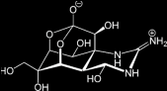
Select Agents
Bacillus anthracis
HHS SELECT AGENTS AND TOXINS | OVERLAP SELECT AGENTS AND TOXINS | USDA PLANT PROTECTION AND QUARANTINE (PPQ)
Abrin | Bacillus anthracis | SELECT AGENTS AND TOXINS
Botulinum neurotoxins | Brucella abortus | Peronosclerospora philippinensis (Peronosclerospora sacchari)
Botulinum neurotoxin producing species of Clostridium | Brucella melitensis | Phoma glycinicola (formerly Pyrenochaeta glycines)
Cercopithecine herpesvirus 1 (Herpes B virus) | Brucella suis | Ralstonia solanacearum race 3, biovar 2
Clostridium perfringens epsilon toxin | Burkholderia mallei (formerly Pseudomonas mallei) | Rathayibacter toxicus
Coccidioides posadasii/Coccidioides immitis | Burkholderia pseudomallei (formerly Pseudomonas pseudomallei) | Sclerophthora rayssiae var zeae
Conotoxins | Hendra virus | Synchytrium endobioticum
Coxiella burnetii | Nipah virus | Xanthomonas oryzae
Crimean-Congo haemorrhagic fever virus | fever virus | Xylella fastidiosa (citrus variegated chlorosis strain)
Diacetoxyscirpenol Rift Valley | Venezuelan Equine Encephalitis virus
Eastern Equine Encephalitis virus
Ebola virus
Francisella tularensis | USDA SELECT AGENTS AND TOXINS
Lassa fever virus | African horse sickness virus
Marburg virus | African swine fever virus
Monkeypox virus | Akabane virus
Reconstructed replication competent forms of the 1918 Avian influenza virus or any CDS thereof | Bluetongue virus (exotic)
Ricin | Bovine spongiform encephalopathy agent
Rickettsia prowazekii | Camel pox virus
Rickettsia rickettsii | Classical swine fever virus
Saxitoxin | Ehrlichia ruminantium (Heartwater)
Shiga-like ribosome inactivating proteins | Foot-and-mouth disease virus
Shigatoxin | Goat pox virus
South American Haemorrhagic Fever viruses | Japanese encephalitis virus
Flexal | Lumpy skin disease virus
Guanarito | Malignant catarrhal fever virus
Junin Mycoplasma capricolum subspecies capripneumoniae | Menangle virus
Machupo | Mycoplasma mycoides subspecies mycoides small
Sabia | colony (MmmSC) (contagious bovine pleuropneumonia)
Staphylococcal enterotoxins | Peste des petits ruminants virus
T-2 toxin | Rinderpest virus
Tetrodotoxin | Sheep pox virus
Tick-borne encephalitis complex (flavi) viruses | Swine vesicular disease virus
Variola major virus (Smallpox virus) | Vesicular stomatitis virus (exotic): Indiana subtypes
Variola minor virus (Alastrim) | VSV-IN2, VSV-IN3
Yersinia pestis | Virulent Newcastle disease virus1
Botulinum neurotoxin
Reconstructed 1918 Flu

Slide 15
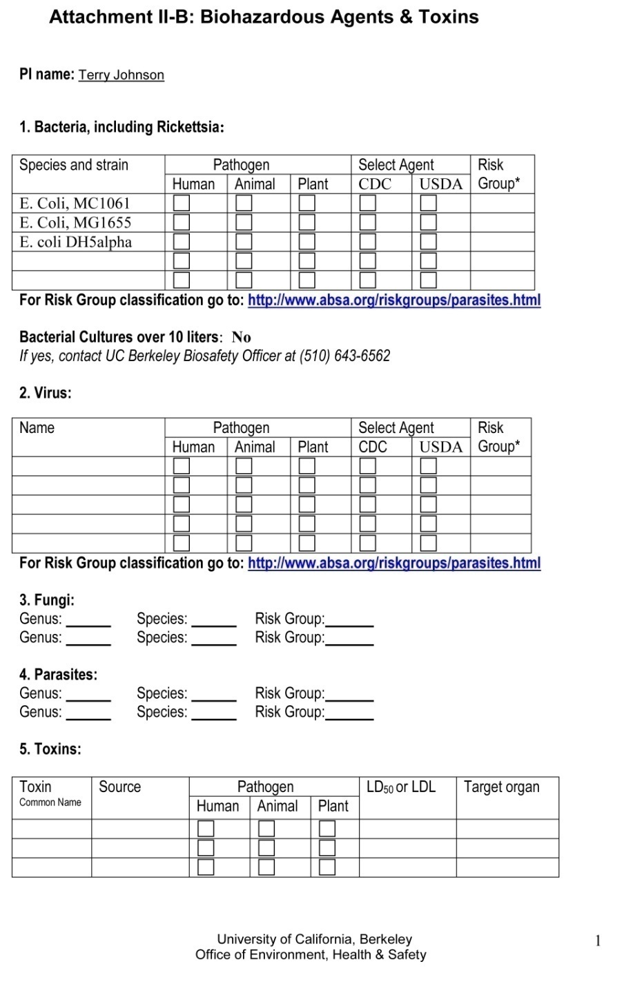
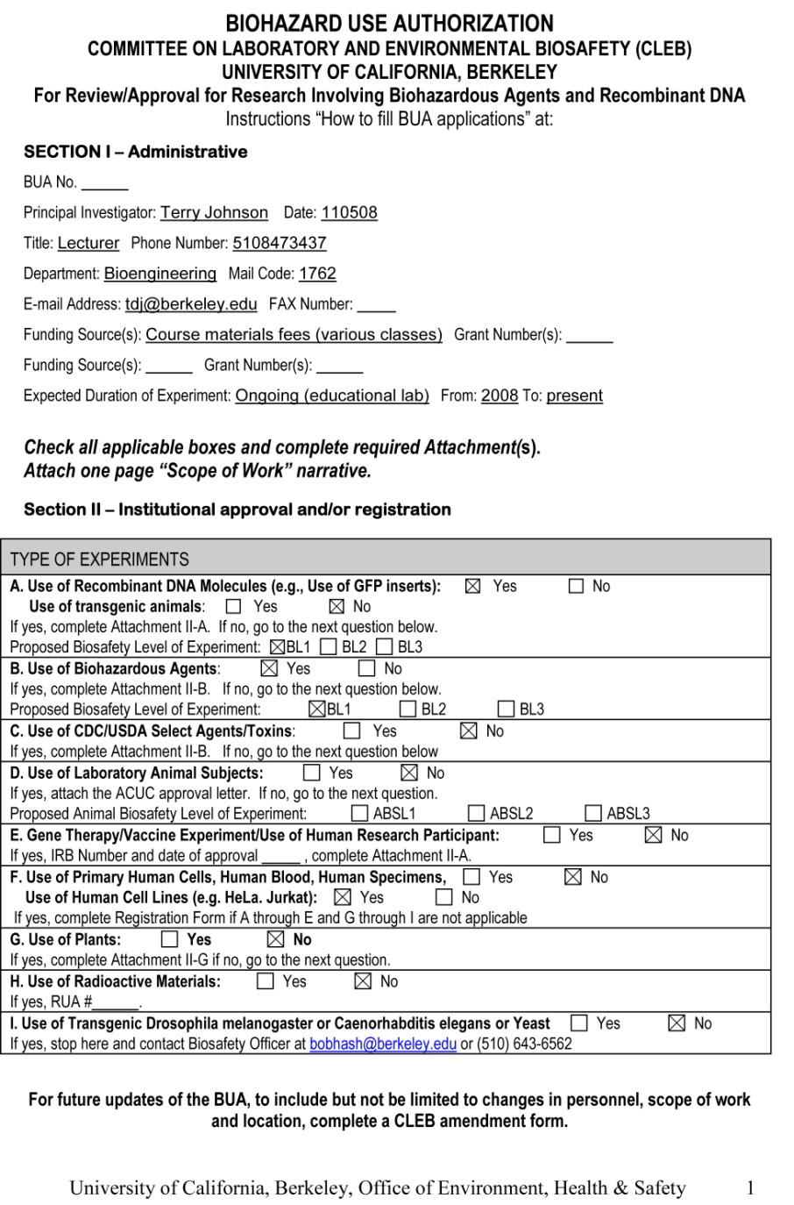
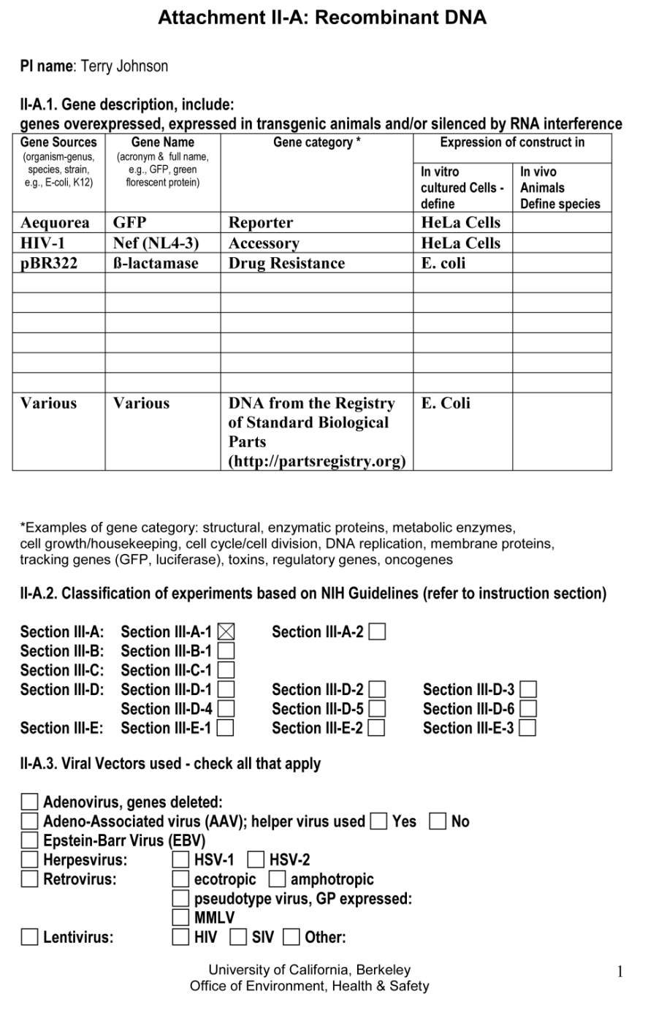
Biological Use Authorization

Slide 16
Enforcement
Punishment
Institutions could lose permits, get shut down, be charged fines, etc.
For “select agents” there is potentially jail time
Prevention
Administrative controls (Ex. Xanthomonas holcicola)
How do administrative controls work in a cheap, fast, available DNA synthesis world?

Slide 17
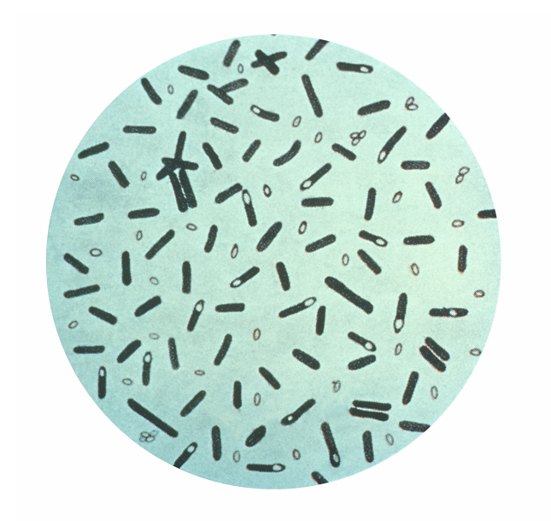
Dual use
Can your work, or part of your work, be used to cause harm in the hands of the unscrupulous?
Example: botulinum toxin (Botox) has a number of medical uses
C. botulinum

Slide 18
Be aware of:
The organization(s) overseeing your work
Appropriate biohazard level
Any select agents involved
Potential for dual use

Slide 19
Conscientious design in Synthetic Biology
Genome synthesis
Unknown behaviors of designed entities
Deskilling with BioCAD tools
Biosecurity in a post-9/11 world

Slide 20
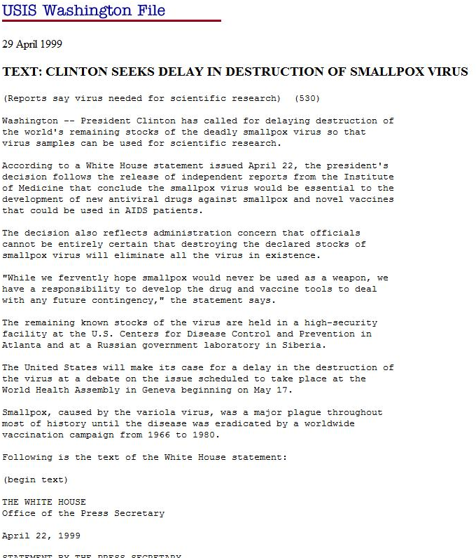
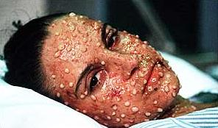
Dangers of gene synthesis:
The smallpox debate
Causitive Agent:
Single linear double stranded DNA genome 186kb in size with hairpin loops at each end.

Slide 21
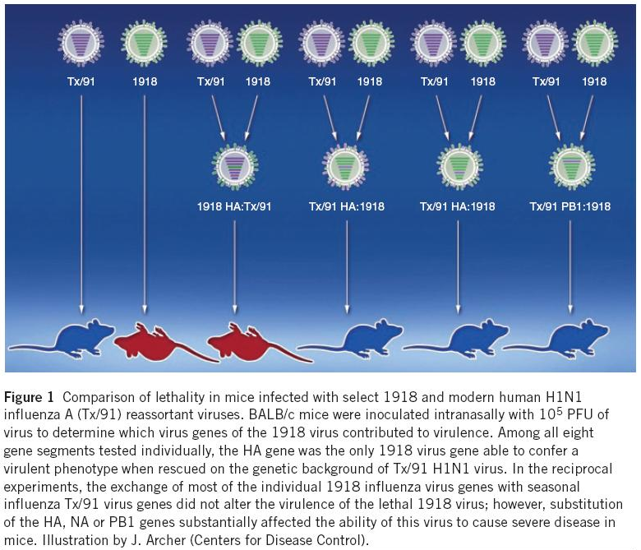
Dangers of gene synthesis:
Reconstitution of 1918 Influenzae Virus
PMID: 20010599

Slide 22

Screening of DNA Synthesis Orders
Gene sequence screening
Compare an order using BLAST-like algorithms against a list of pathogen genes
Customer screening
Customers need a shipping address and institution, no PO boxes
Screen customers against various ‘denial’ lists
Additional screening if a pathogen-derived sequence is involved
Record Keeping
Keep track of sequence, customer, and address for 8 years
Order Refusal and Reporting
Companies can refuse an order and contact national law enforcement
http://www.genesynthesisconsortium.org/wp-content/uploads/2012/02/IGSC-Harmonized-Screening-Protocol1.pdf

Slide 23
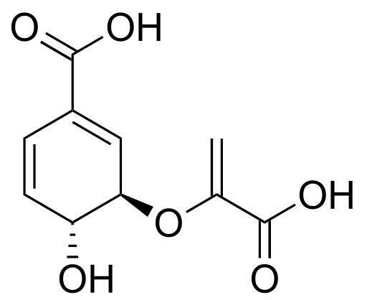
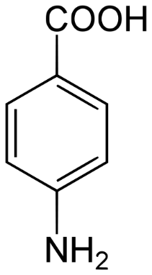
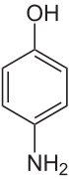
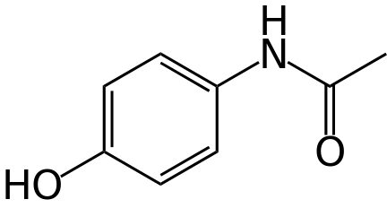
Tylenol
pabABC
4ABH
nhoA
entB, trpE, pheA, tyrA
folP, (ubiA)
Acetaminophen is lethal at 12 g
What of a biosynthetic organism?
Precautions: ΔdapD strain, bleach
Notes:
A virulence feature is a feature that is implicated as part of a virulence factor (or it itself encodes the virulence factor). There are databases of these things. Clotho does this automatically.

Slide 24
Questions to ask yourself
Are there select agents involved?
If yes, consider alternative strategies—this is a red flag that you probably do not want to do this project. Software can catch this. Gene Synthesis companies will catch this.
Are there virulence features involved?
If yes, do they really need to be there? If yes, you are probably making something that could carry some real health risks, so you need to think through pathogenicity risks, and probably talk it over with experts. There are many “safe” virulence factors, but some risks are not immediately obvious.
3) Are you creating anything that in effect is a virulence factor?
Do any of your devices, despite being made of non-virulence features, nevertheless do something that affects the interactions between your organism and animal/plant cells? If so, it should be considered to be comparable in risk to virulence factors that do similar things.
Can mutation of your devices result in a dangerous organism?
For each device you have in your system, consider all variants that break one feature, all variants that transpose one region of the system with another (including the genome). If any of those result in a dangerous device, the original construct should be considered potentially dangerous.
5) Are you enabling the dissemination of genetic material?
Are you enabling your organism to share its DNA with other organisms? Are you producing genetic particles (like phages) that can enable horizontal gene transfer?
6) Are you creating a dual use risk (biosecurity threat)?
Are the devices you are making specifically reusable for some nefarious purpose? Can any of the features you are making available be reused as such?
Notes:
A virulence feature is a feature that is implicated as part of a virulence factor (or it itself encodes the virulence factor). There are databases of these things. Clotho does this automatically.

Slide 25
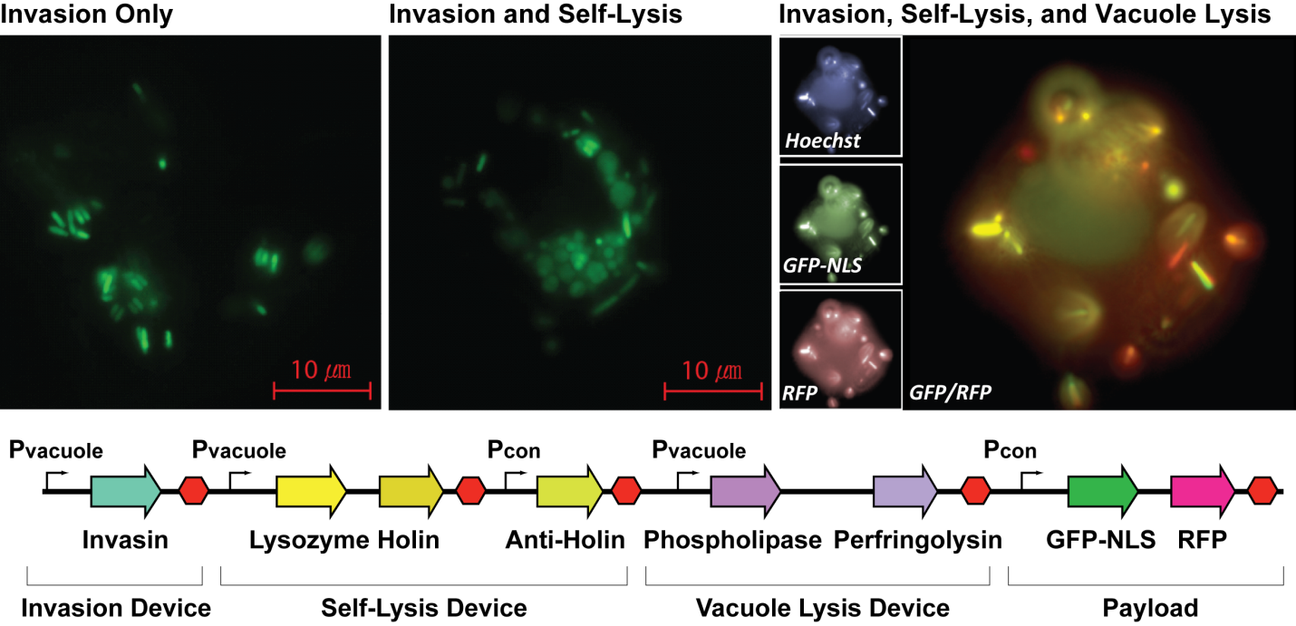
Payload Delivery Device
http://dx.doi.org/10.1021/sb300107h
Source organism risk group:
1
2
1
1
1
1
1
1
2
2
1
1
1
1
1
Notes:
A virulence feature is a feature that is implicated as part of a virulence factor (or it itself encodes the virulence factor). There are databases of these things. Clotho does this automatically.

Slide 26
Containment Strategies
Use of crippled strains (lab strains of E. coli)
Employment of auxotrophs (ΔdapD)
Eliminate high-affinity iron transport (ΔtonB)
Use of kill-switches or engineered safety catches
http://www.frontiersin.org/Microbiotechnology,_Ecotoxicology_and_Bioremediation/10.3389/fmicb.2013.00005/full
Notes:
A virulence feature is a feature that is implicated as part of a virulence factor (or it itself encodes the virulence factor). There are databases of these things. Clotho does this automatically.

Slide 27
Perception and Hypothetical Risks
Notes:
Genetic engineering has always raised concerns about its potential for causing harm in the realm of biosafety. It has also raised concern over the potential for dishonesty about these risks due to conflicts of interest. Additionally, there is concern that the scientists involved might encounter hazards that were not anticipated. In reality, there is now a 40-year track record for genetic engineering without a single incident. However, this was not immediately apparent at the onset of the field.

Slide 28
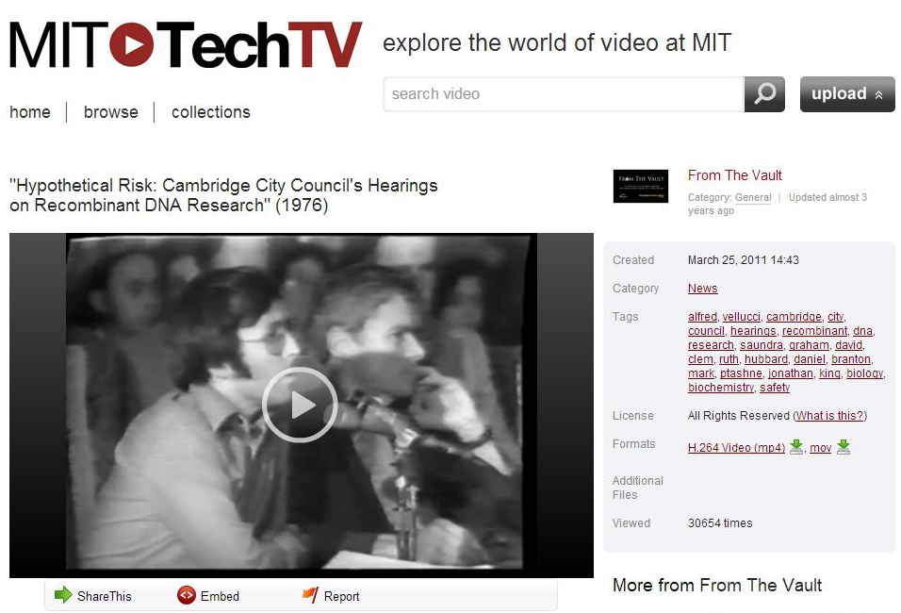
http://ttv.mit.edu/videos/11570-hypothetical-risk-cambridge-city-councils-hearings-on-recombinant-dna-research-1976
Notes:
This video is a series of clips from a Cambridge City Council Hearing on Recombinant DNA Research from 1976. To put this in context, it was only 3 years early that Herbert Boyer and Stanley Cohen demonstrated that you could clone a gene into a plasmid using restriction enzymes. At the time of this meeting, the ability to deliberately change the genetic blueprint of the cell was brand new. Accordingly, there was no track record to point at as a starting point for conversations around risk. Understandably, the debate was heated. Ultimately, this city council meeting resulted in a 6 month moratorium on the use of recombinant DNA technology and was a key event in establishing standards for oversight, risk analysis, and risk mitigation.

Slide 29
Hypothetical Risks
http://ttv.mit.edu/videos/11570-hypothetical-risk-cambridge-city-councils-hearings-on-recombinant-dna-research-1976
More interesting sections…
Sandra Graham 8:45-10:25 Since politicians are being asked to settle it, there must be some great internal debate amongst the scientific community.
David Clem 10:40-12:45 Isn’t it a conflict of interest for the NIH to fund and enforce all this?
??? 20:30-21:20 We need a moritorium…and there was one for 6 months
Ruth Hubbard 22:24-24: 33 There are unknown unknowns, particularly with E. coli
Notes:
Up first is city councilwoman Sandra Graham. She expresses concern over the entire context of such a meeting. She posits that since politicians are being asked to settle it, there must be some great internal debate amongst the scientific community. As the meeting progresses, indeed there are scientists on both sides of the aisle in a way that is less pronounced today. However, there is some intrinsic truth to her statement. If we had clear and consistent theory about how risk emerges in genetic engineering, there would not be a need for a public debate about what these risks were. As of 2014, we have great experience with the technology, but there is still no overarching theory.

Slide 30
Hypothetical Risks
http://ttv.mit.edu/videos/11570-hypothetical-risk-cambridge-city-councils-hearings-on-recombinant-dna-research-1976
More interesting sections…
Sandra Graham 8:45-10:25 Since politicians are being asked to settle it, there must be some great internal debate amongst the scientific community.
David Clem 10:40-12:45 Isn’t it a conflict of interest for the NIH to fund and enforce all this?
??? 20:30-21:20 We need a moritorium…and there was one for 6 months
Ruth Hubbard 22:24-24: 33 There are unknown unknowns, particularly with E. coli
Notes:
David Clem raises concerns about an intrinsic conflict of interest for the NIH to both fund research using recombinant DNA and to provide the regulatory oversight for the technology. Such conflicts still exist. Though the track record of NIH oversight is impeccable, it has a limited scope. It only deals with concerns over human, animal, and to some degree plant health. It does not include risks to the environment, to commerce, or general well-being.

Slide 31
Hypothetical Risks
http://ttv.mit.edu/videos/11570-hypothetical-risk-cambridge-city-councils-hearings-on-recombinant-dna-research-1976
More interesting sections…
Sandra Graham 8:45-10:25 Since politicians are being asked to settle it, there must be some great internal debate amongst the scientific community.
David Clem 10:40-12:45 Isn’t it a conflict of interest for the NIH to fund and enforce all this?
??? 20:30-21:20 We need a moritorium…and there was one for 6 months
Ruth Hubbard 22:24-24: 33 There are unknown unknowns, particularly with E. coli
Notes:
The next speaker proposes a moratorium on recombinant DNA technology. Indeed, this is the result of the meeting. There was such a moratorium for 6 months before research resumed.

Slide 32
Hypothetical Risks
http://ttv.mit.edu/videos/11570-hypothetical-risk-cambridge-city-councils-hearings-on-recombinant-dna-research-1976
More interesting sections…
Sandra Graham 8:45-10:25 Since politicians are being asked to settle it, there must be some great internal debate amongst the scientific community.
David Clem 10:40-12:45 Isn’t it a conflict of interest for the NIH to fund and enforce all this?
??? 20:30-21:20 We need a moritorium…and there was one for 6 months
Ruth Hubbard 22:24-24: 33 There are unknown unknowns, particularly with E. coli
Notes:
Our final clip is from Ruth Hubbard. She is one of a minority of voices with expertise in microbiology raising concerns specifically about the use of E. coli. Because coli is a human commensal, there is the risk of infection of the researches and potential spread to others. The last 40 years of genetic engineering has focused mostly only overexpressing a single gene in highly-degenerated strains of E. coli, and the ability of these organisms to act even as commensals is greatly compromised. However, as the field begins tackling more sophisticated applications such as live therapeutics including engineered probiotics and vaccines, this potential for infection and spread will need to be reconsidered.

Slide 33
Hypothetical Risks
http://ttv.mit.edu/videos/11570-hypothetical-risk-cambridge-city-councils-hearings-on-recombinant-dna-research-1976
More interesting sections…
Sandra Graham 8:45-10:25 Since politicians are being asked to settle it, there must be some great internal debate amongst the scientific community.
David Clem 10:40-12:45 Isn’t it a conflict of interest for the NIH to fund and enforce all this?
??? 20:30-21:20 We need a moritorium…and there was one for 6 months
Ruth Hubbard 22:24-24: 33 There are unknown unknowns, particularly with E. coli
Assumptions: the risks of genetically engineered organisms is not knowable, and there is a chance that the events that can occur are ‘significant’.
Are lab strains of E. coli containing GFP potentially dangerous?
Notes:
In the realm of hypothetical risks, there are some underlying assumptions about what is possible which are probably inaccurate. For example, it is somehow chemically obvious that a GFP-overexpressing E. coli could never become a dangerous object. However, the mechanistic basis for ruling out all potential for risk in such organisms has not been established. As our field progresses towards a more knowledge-based and disciplined approach to design, these considerations of risk mechanisms will need to be flushed out and considered up front before fabrication.

Slide 34

Questions to Ponder

Slide 35
A student on an iGEM team made a basic part out of Shiga toxin from Enterohemorrhagic E. coli as a cancer-killing device component and sent it into the Registry. Do you see any problems with that?
Some researchers have developed an anti-sperm vaccine…

Slide 36
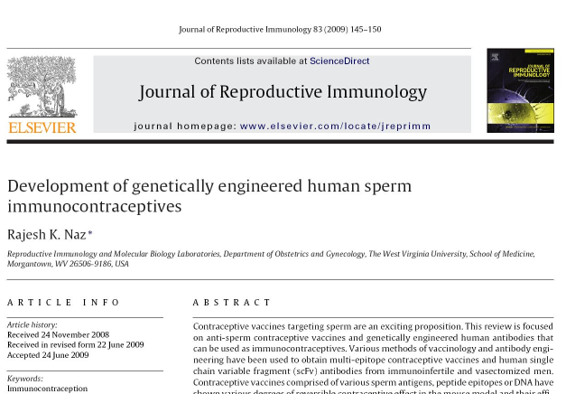
Sperm Vaccine

Slide 37
Sperm Vaccine
70% of vasectomized men produce anti-sperm antibodies (ASA) and 2–30% of cases of infertility may be associated with the presence of ASA in the male and/or female of an infertile couple
Contraceptive vaccines have been successfully used in controlling feral populations of deer, horses, elephants, and several species of zoo animals
The goal here was to identify epitopes that elicit antibodies effective in causing infertility
This lab uses phage display to identify scFv antibodies that react with sperm
Could be used for “passive immunization” or for the development of actual vaccines
Involves phage that display anti-sperm antibodies, bacteria expressing these antibodies, potentially bacteria producing sperm epitopes as fusion proteins

Slide 38
A student on an iGEM team made a basic part out of Shiga toxin from Enterohemorrhagic E. coli as a cancer-killing device component and sent it into the Registry. Do you see any problems with that?
Some researchers have developed an anti-sperm vaccine…
A stem cell researcher has developed a strategy to take fibroblasts from a patient, analyze the transcriptome of the cells with omics tools, and then customize a synthetic biology-derived cell therapy for heart regeneration after heart attack. Since the cells are not derived from embryos, the usual ethical/moral questions regarding the therapy are not a concern, but are there other issues for such a therapy?

